Slide 1





BATTERY THERMAL MANAGEMENT USING HEAT PIPE INTEGRATED IMMERSION COOLING AND AIR CONDITIONING SYSTEM
KONGU ENGINEERING COLLEGE
PERUNDURAI ERODE-638060
DEPARTMENT OF AUTOMOBILE ENGINEERING
Team Mentor with Designation and Department:
Dr. P. C. Murugan /Associate Professor / Auto. Engg.
Team Co-Mentor with Designation and Department:
Mr. K.Nithyanandhan / Assistant Professor / Auto. Engg.
In association with:

Slide 2
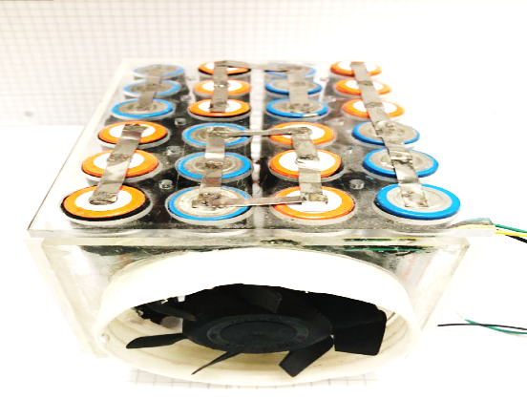

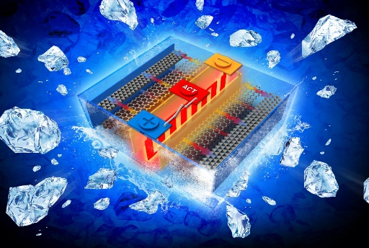

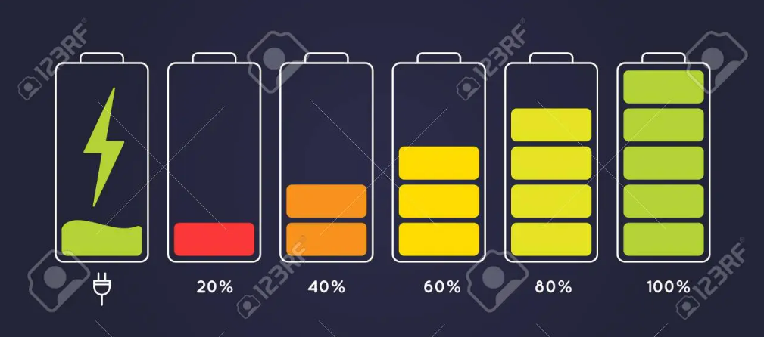


PROBLEM STATEMENT
Existing Technologies
Heating Issues
Cooling
\
Electric Vehicle
Air Cooling
Reasons
Excess Emission From IC fuelled Vehicle
Charging & Discharging
Environmental condition

Slide 3
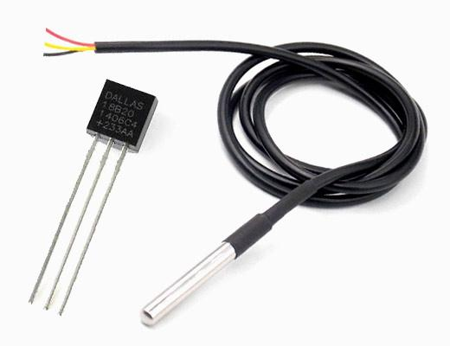
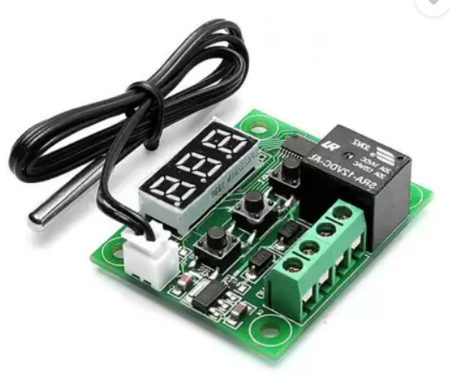

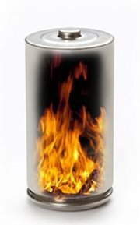
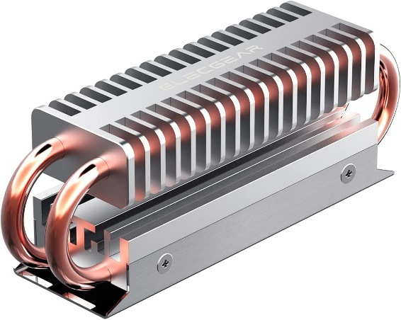
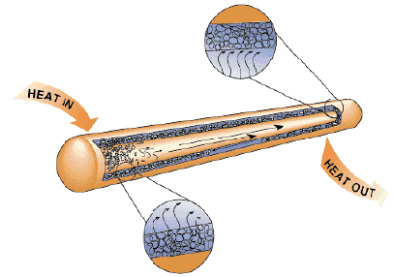
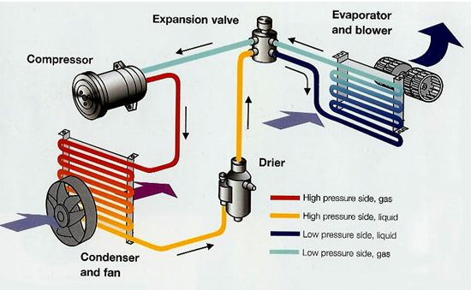

SOLUTION
Heat Removed From Battery Pack
Cell
Heat
Control Module
Temperature Sensor
Heat From the Cell
Result
Heat Pipe Integrated System
Heat Pipe
Air conditioning system

Slide 4
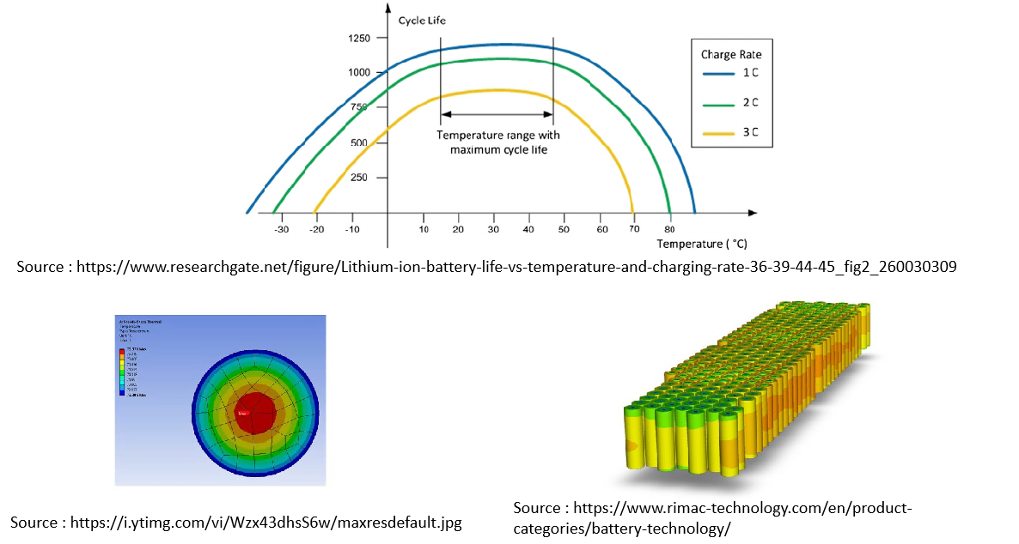

Slide 5

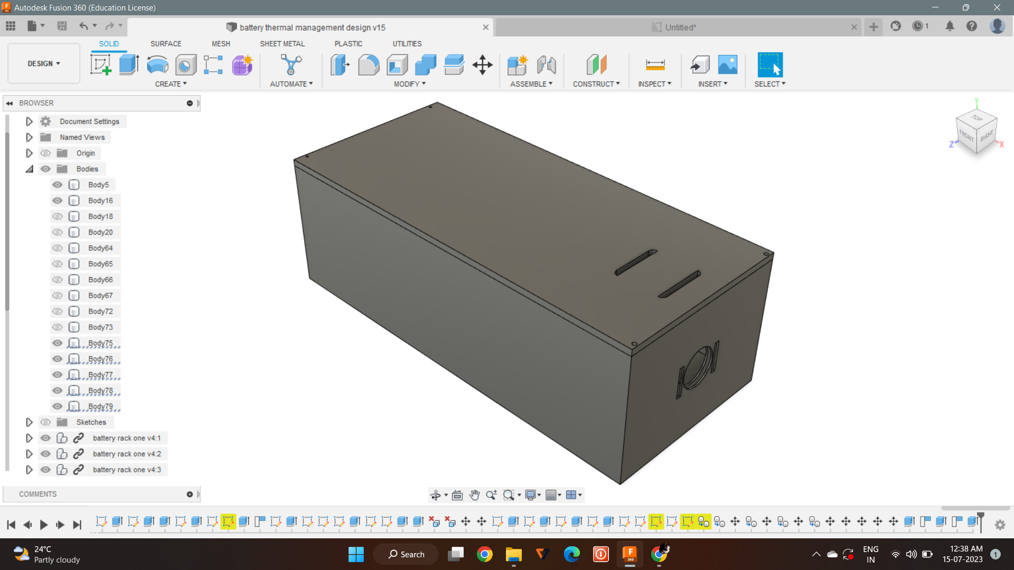
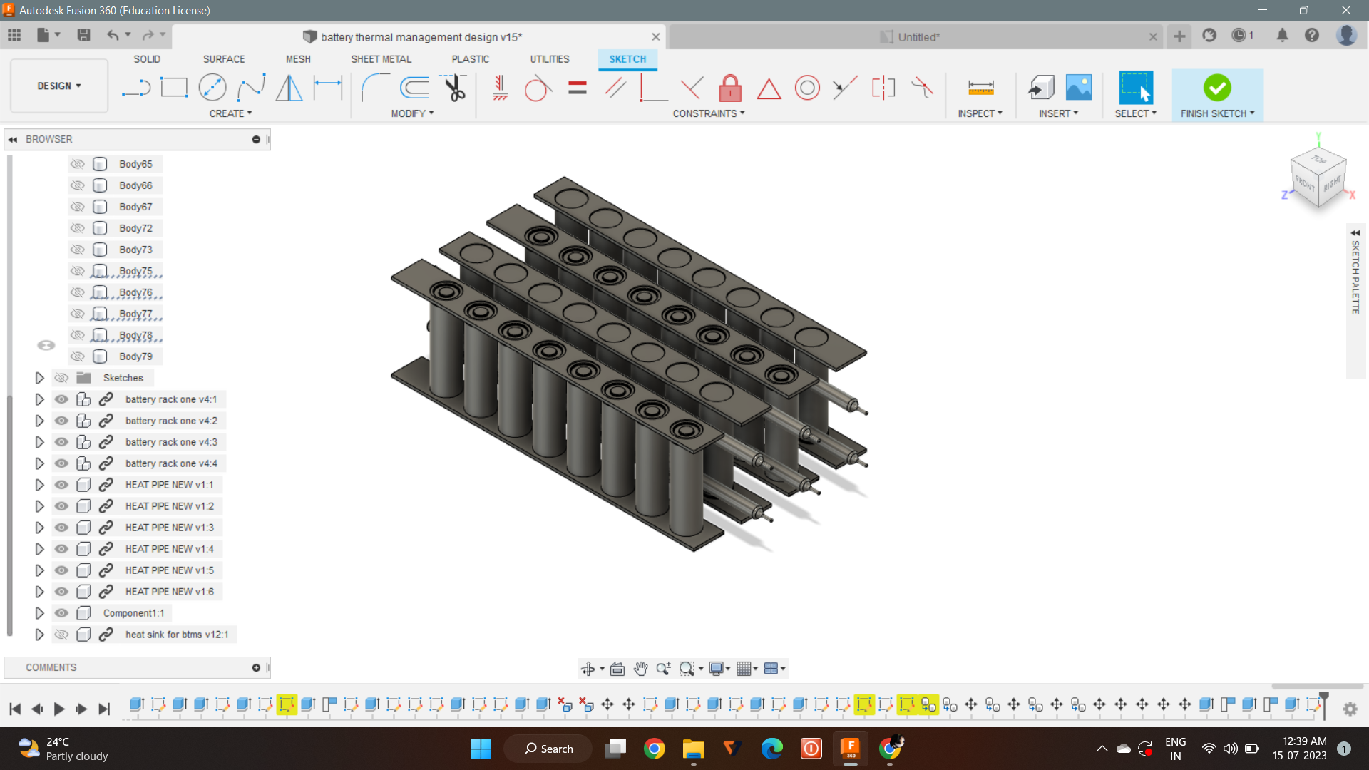
INNOVATION
Heat pipe integrated system with immersion cooling.
Battery pack model for Thermal management of li-ion batteries using Heat pipe techniques.
Air conditioning system is connected with the battery pack.
Dielectric liquid integrated with the heat pipe system.
Effective and leakage free.
Uniform temperature distribution.
CAD Model of the Battery Pack
CAD Model of the Integrated System

Slide 6
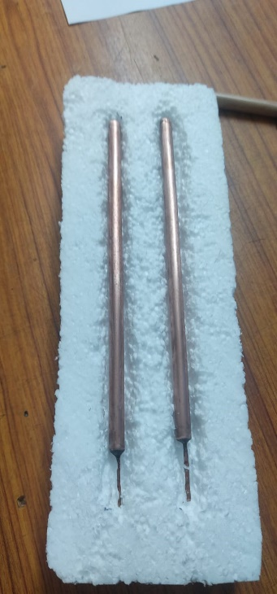
Heat Pipe Specification
Heat Pipe
Outer Diameter | 8 mm
Inner Diameter | 6.5 mm
Length | 190 mm
Wick Mesh | Screen Mesh
Material | Copper
Working Fluid | Acetone
Fill Ratio | 30 %
Pressure | 0.1 bar
Evaporator Section

Slide 7
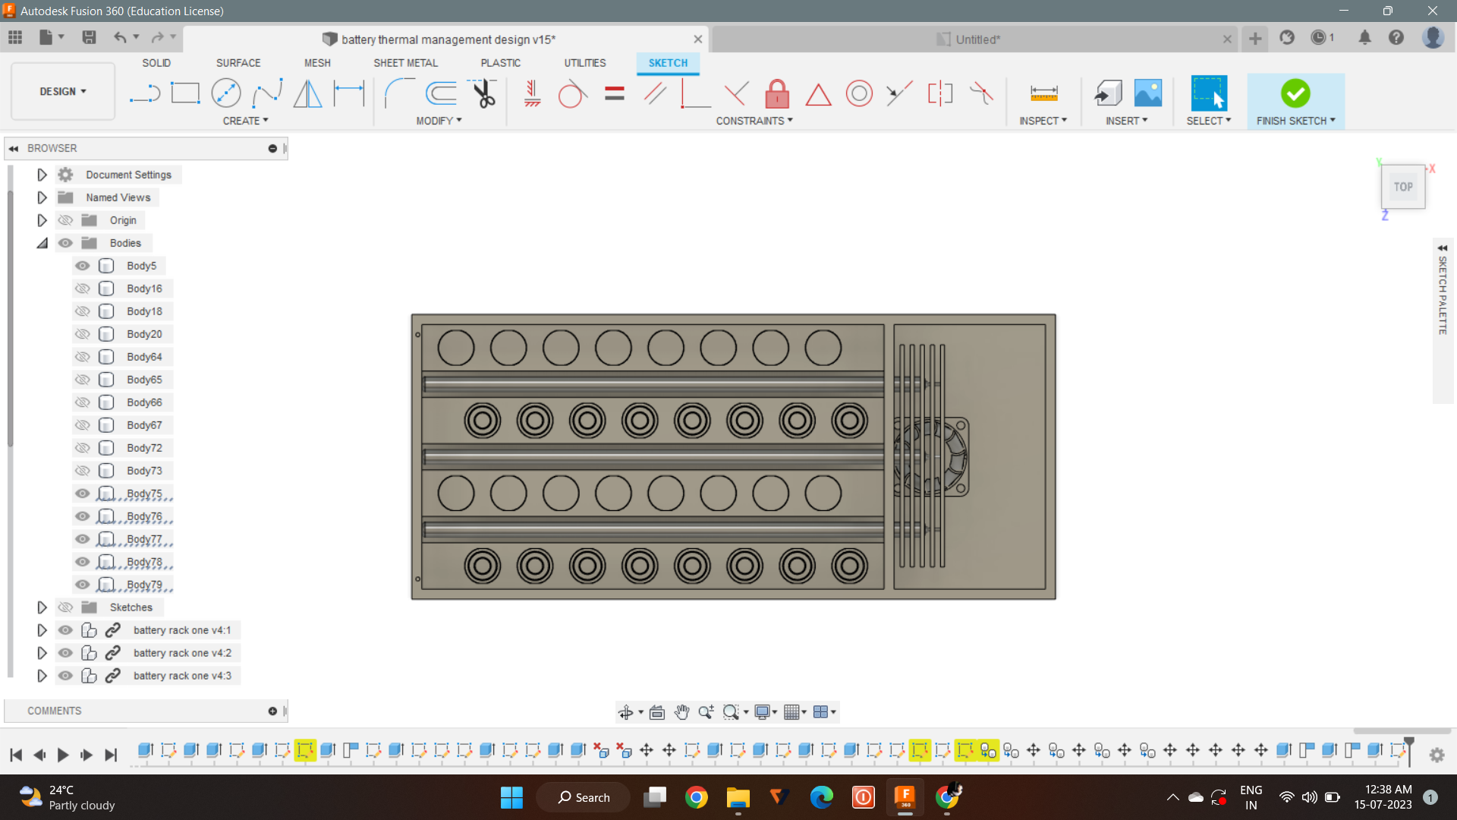
TOP VIEW OF THE BATTERY PACK

Slide 8
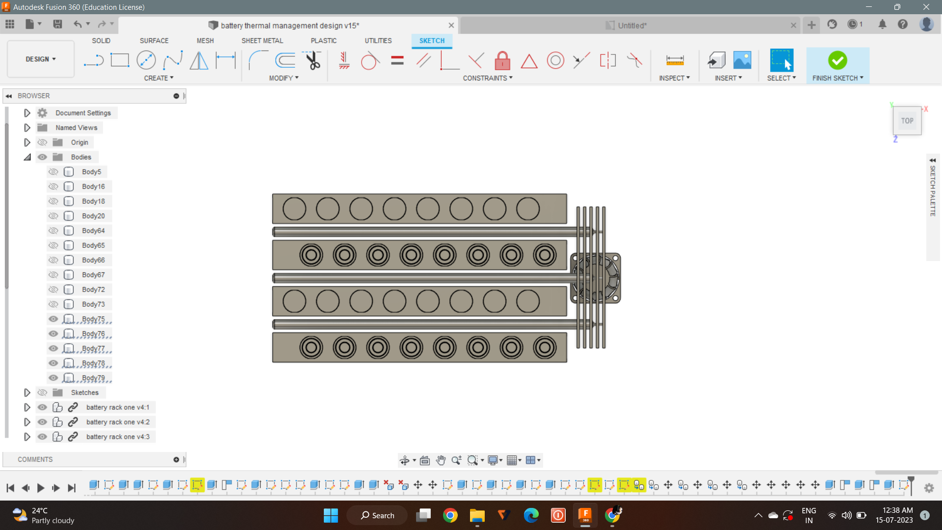
TOP VIEW

Slide 9
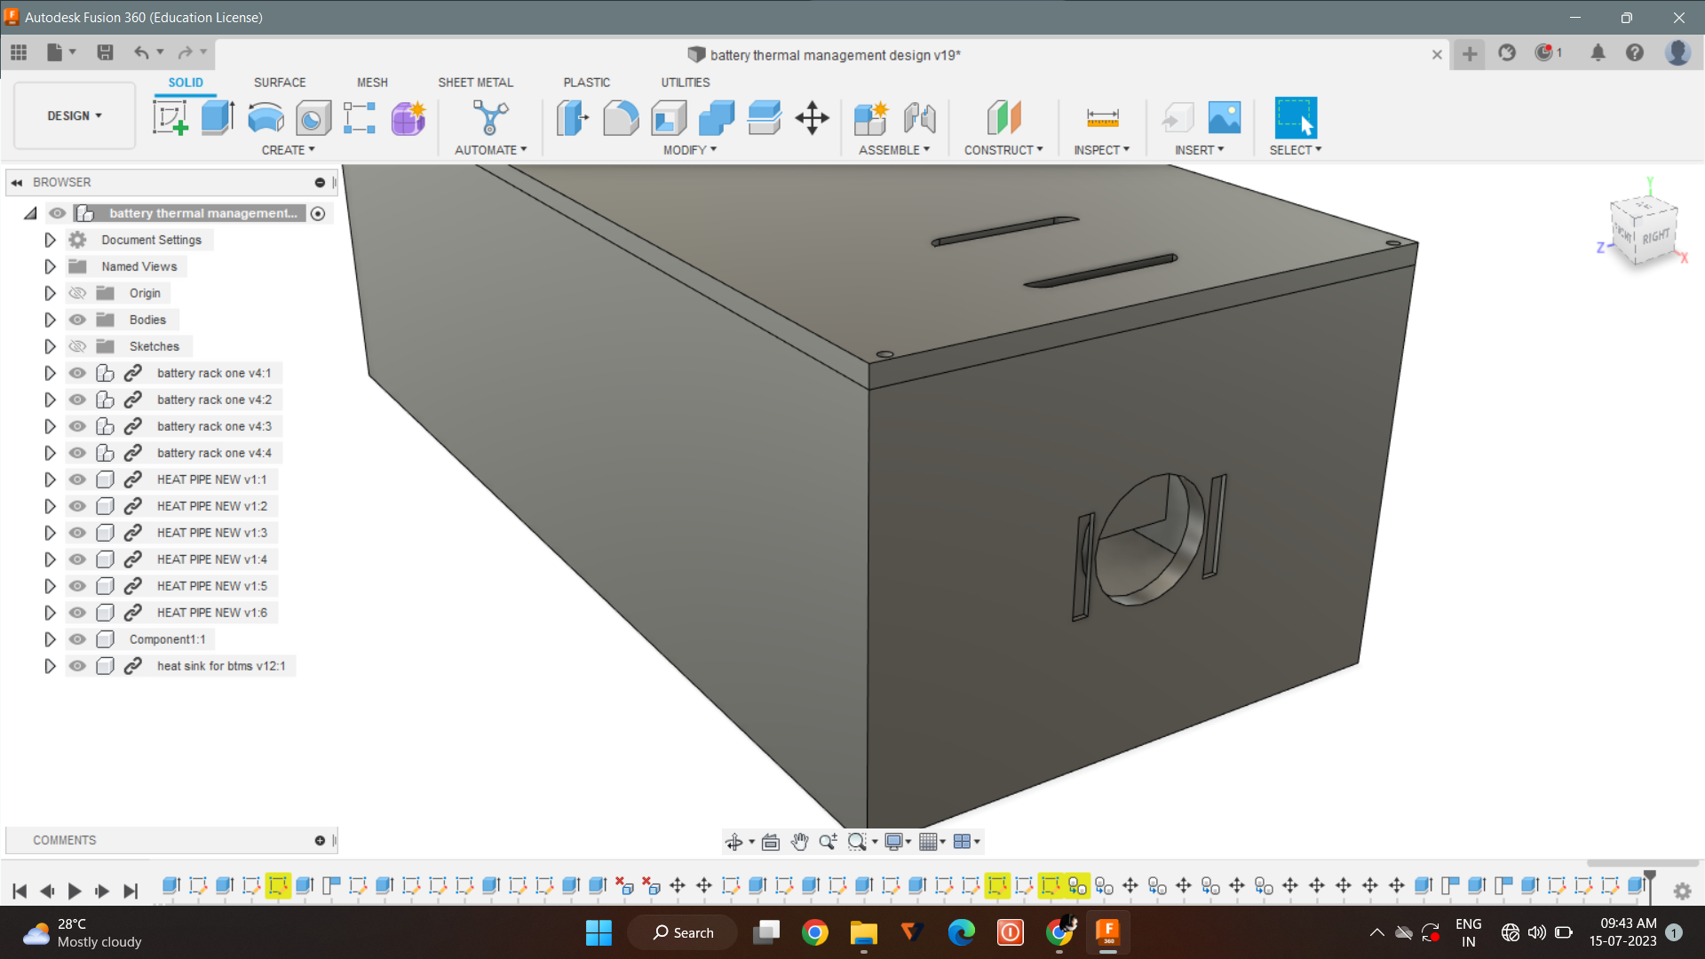
AIR VENTS

Slide 10
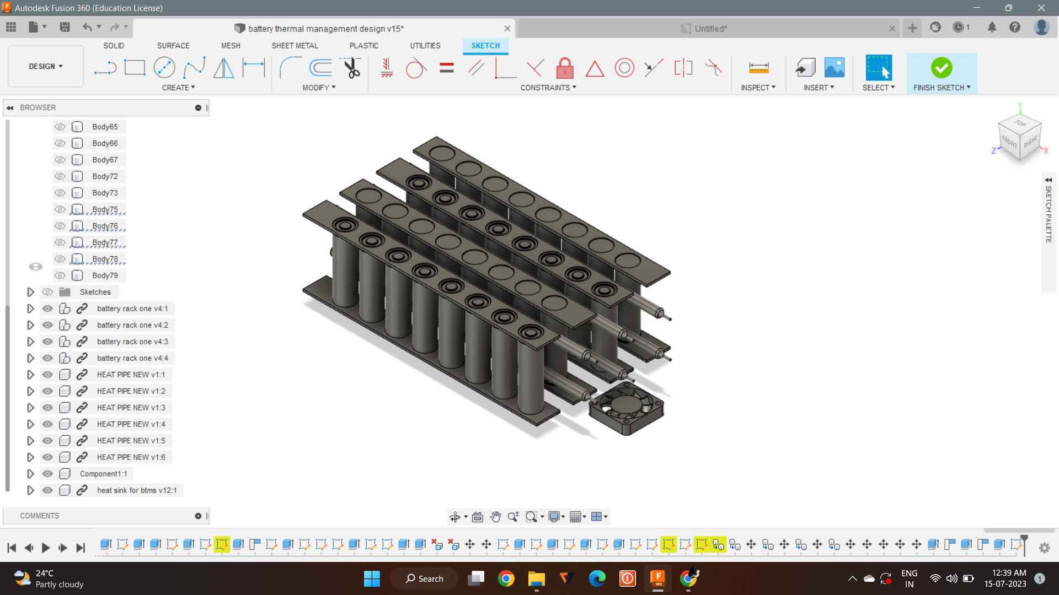
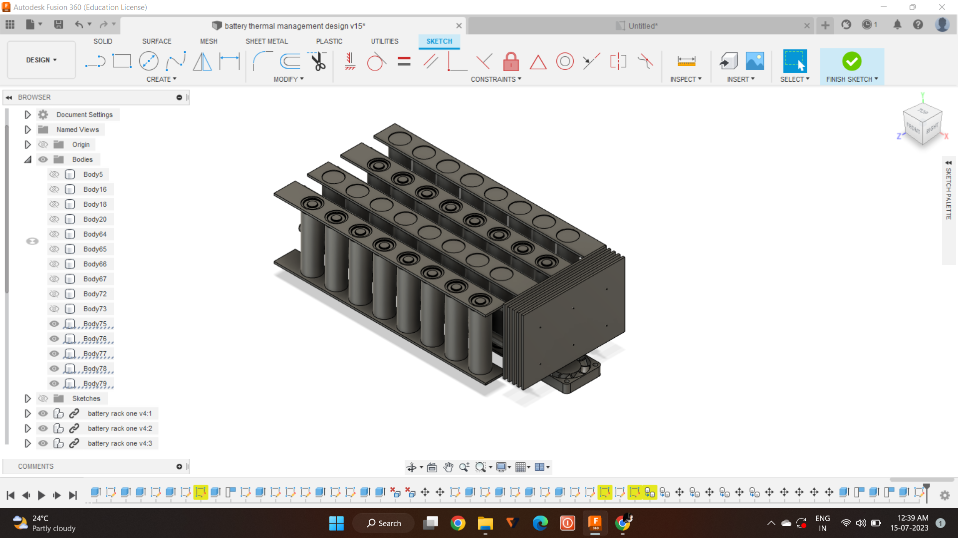
CAD MODELLING
3D view

Slide 11
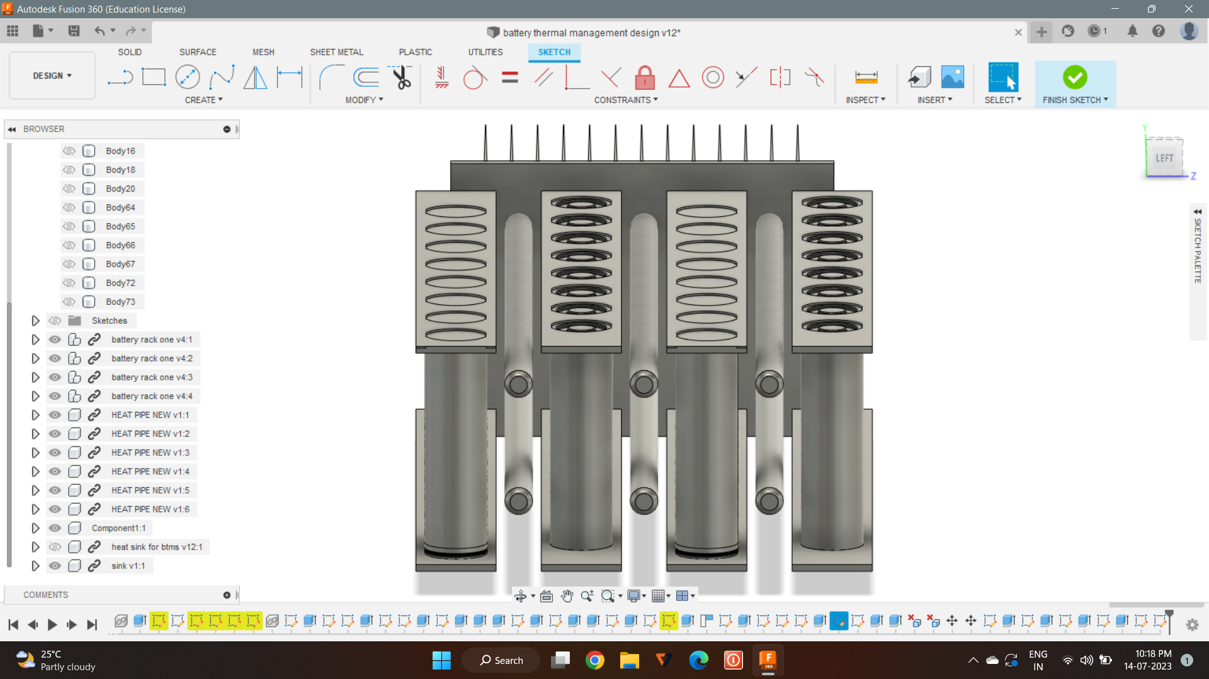
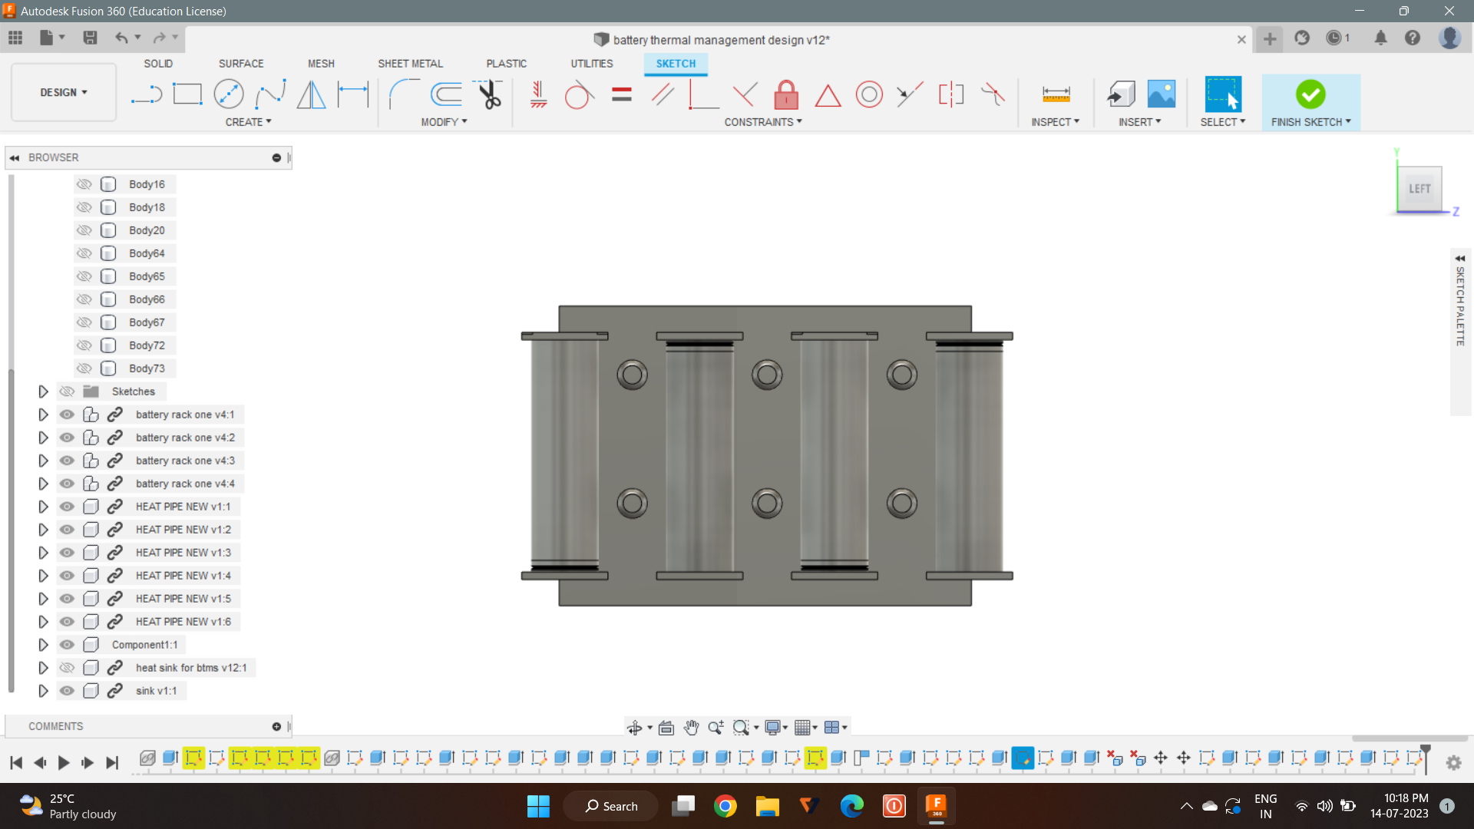
CELL AND HEAT PIPE SETUP

Slide 12
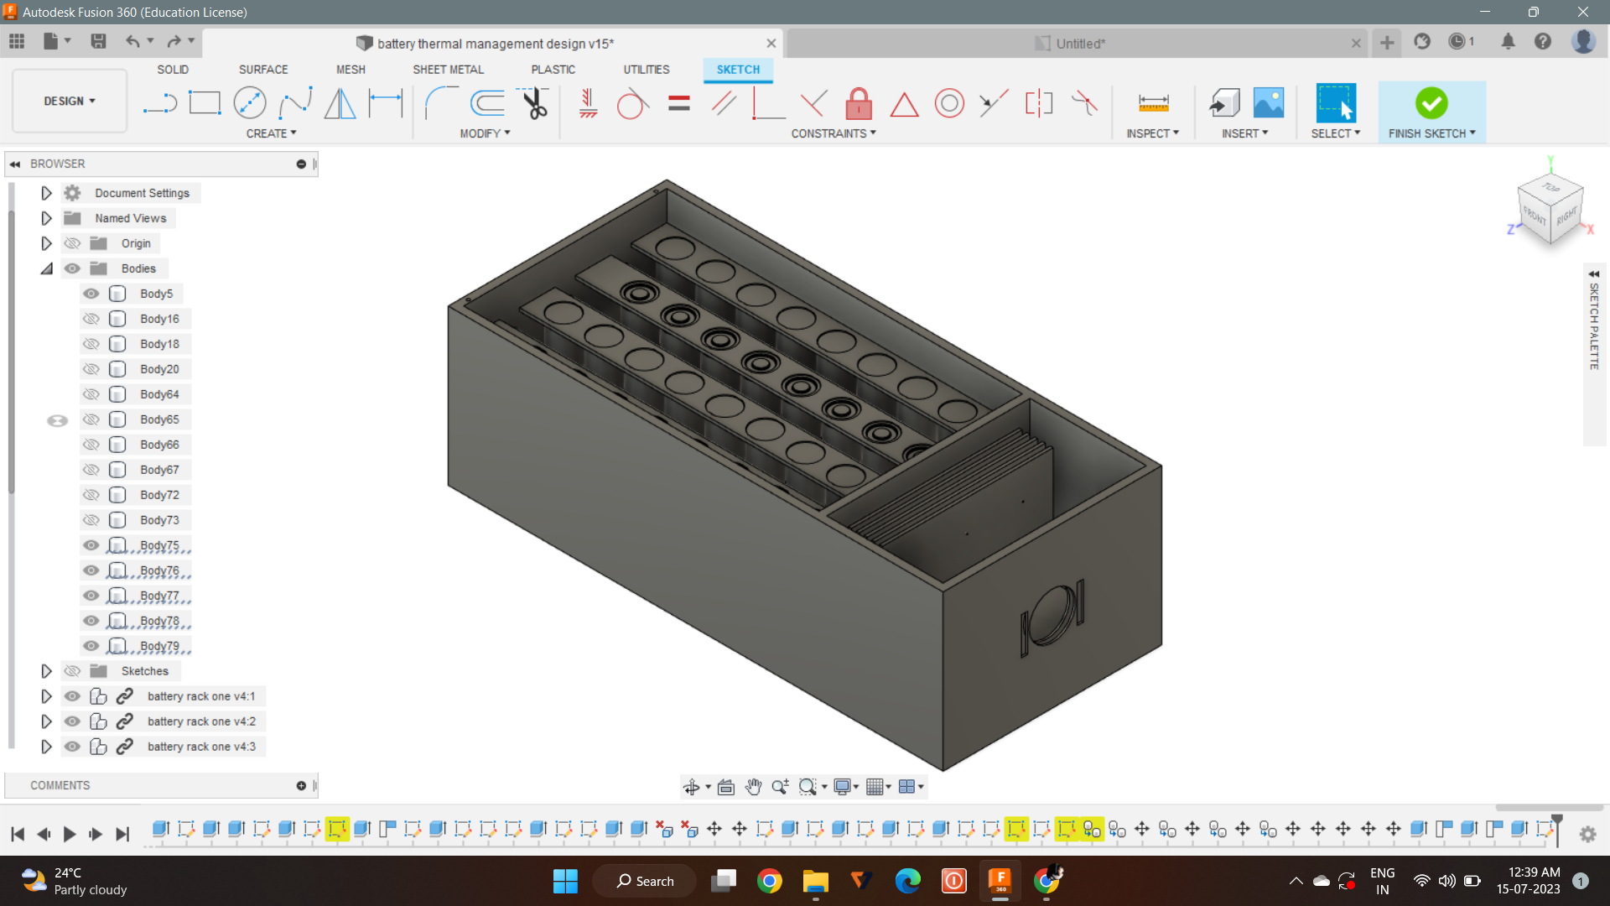
OVERALL BATTERY PACK SETUP

Slide 13

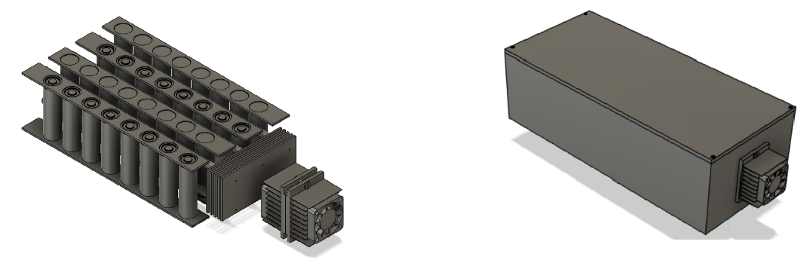

Slide 14
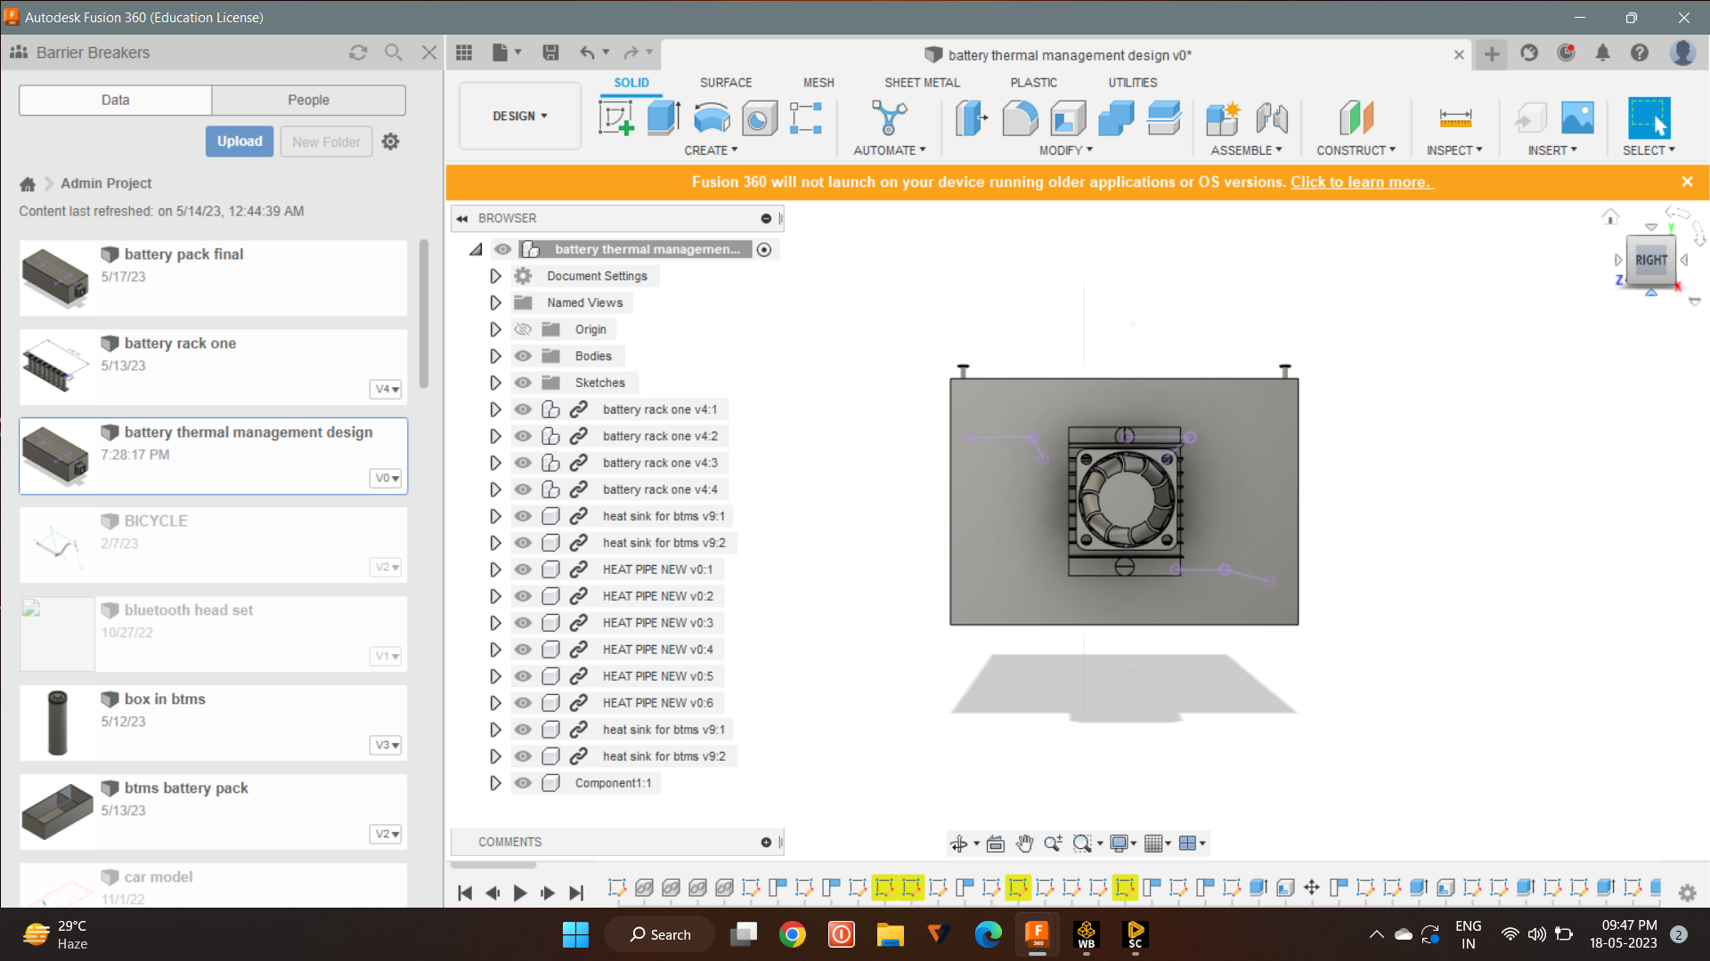
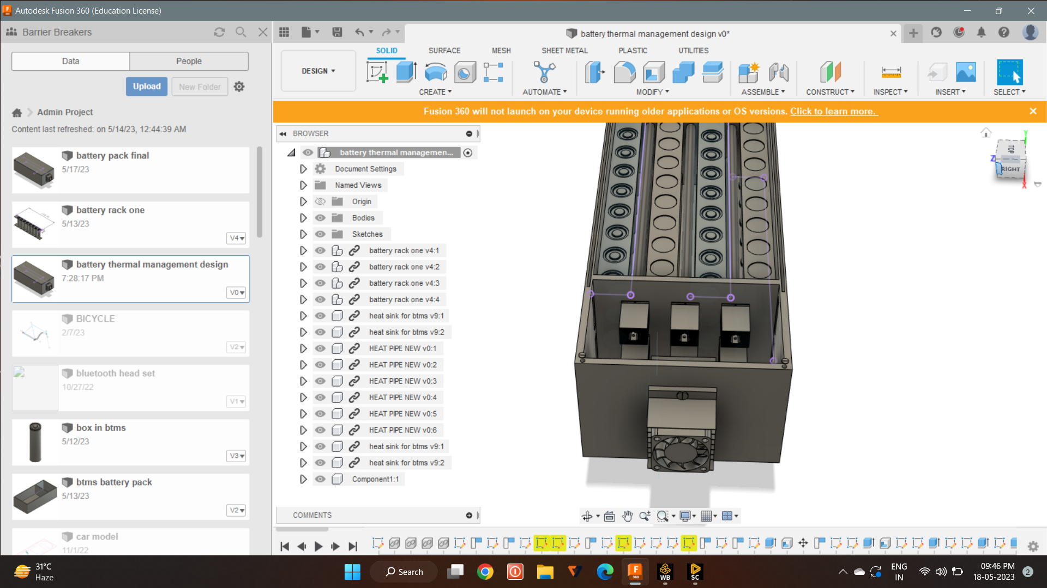
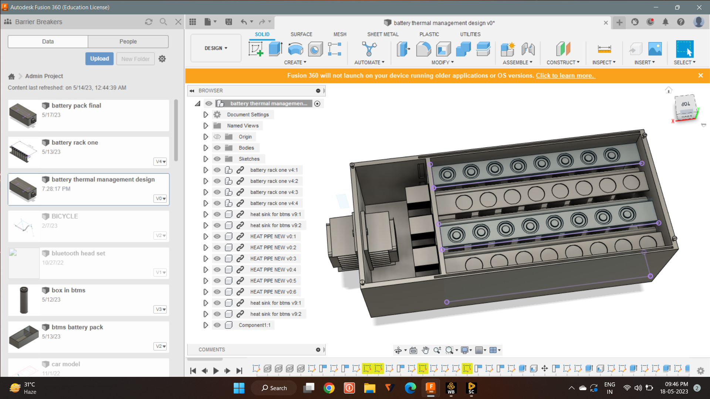
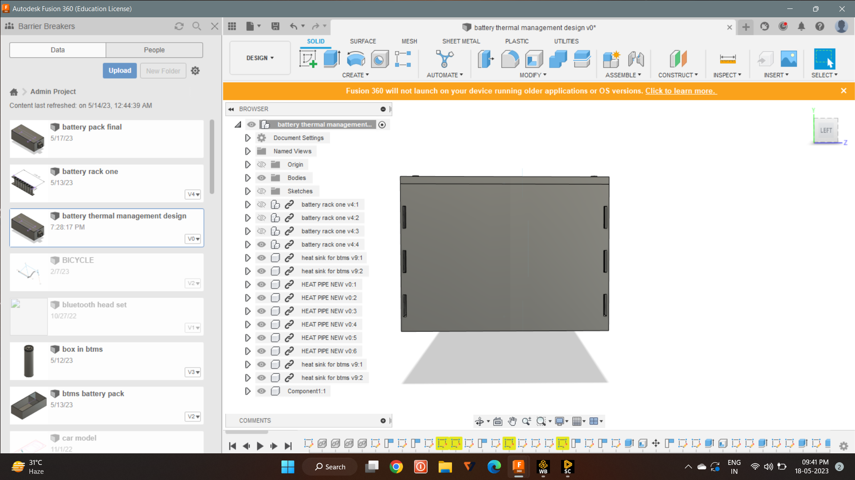

Slide 15
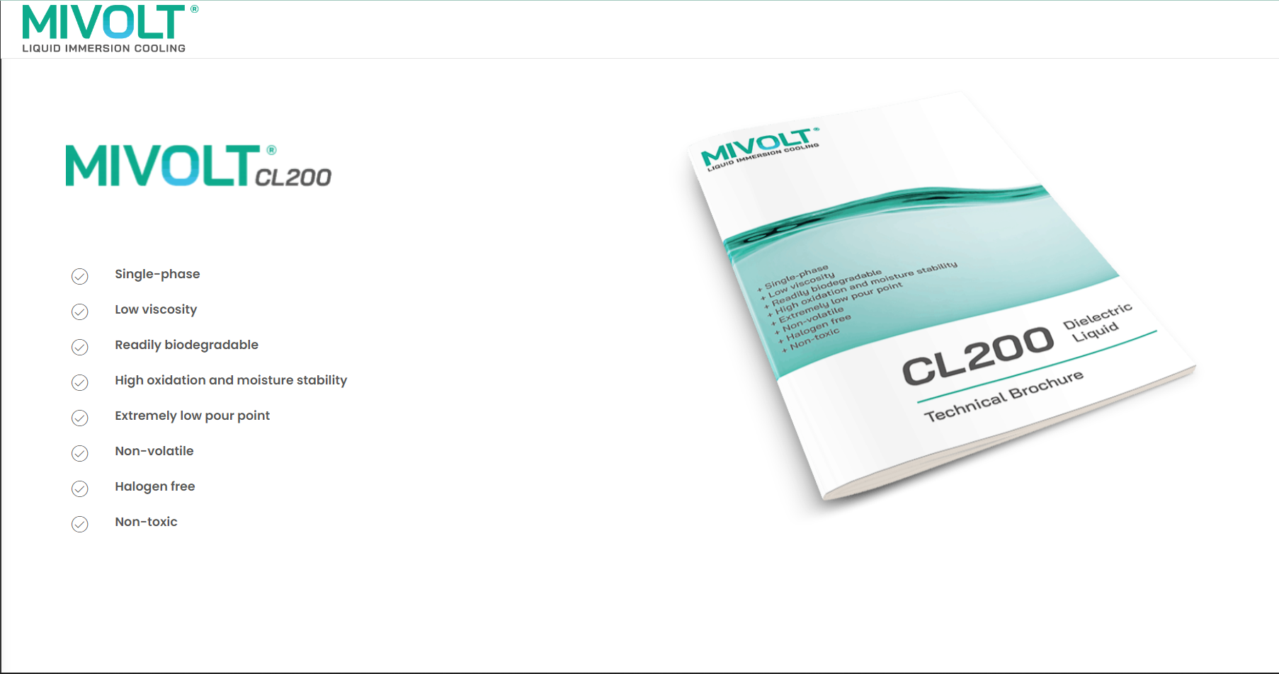
MIVOLT Dielectric fluid

Slide 16
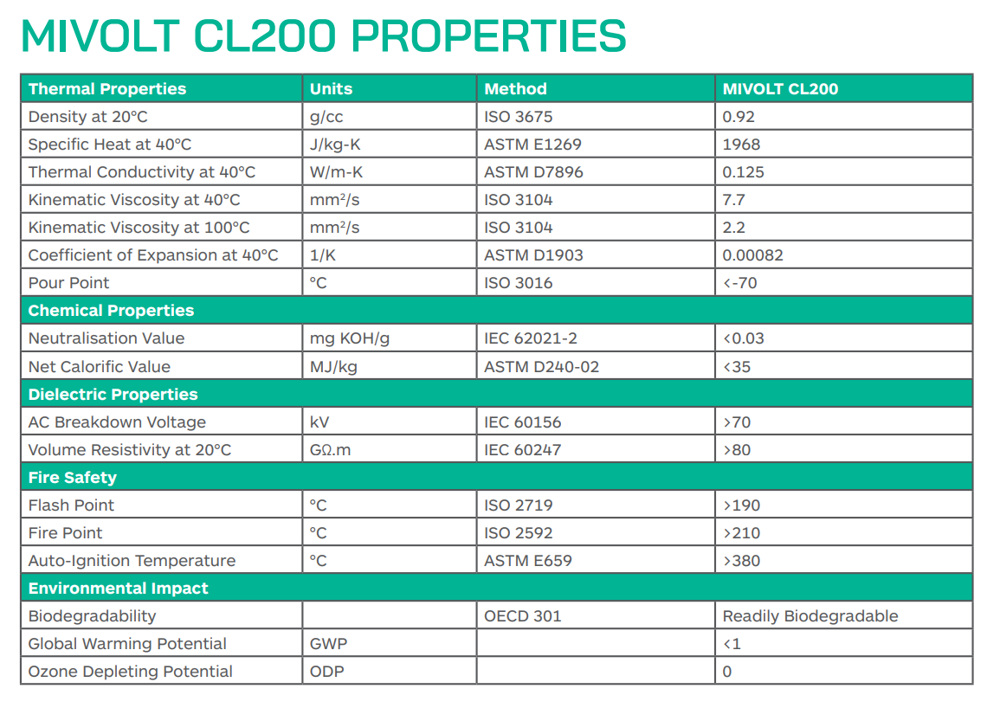

Slide 17
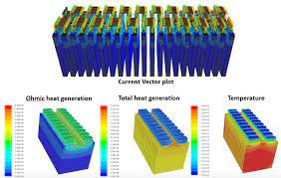
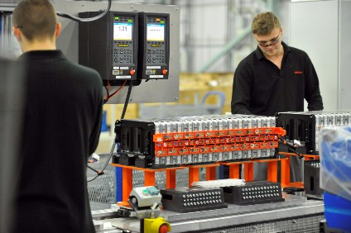
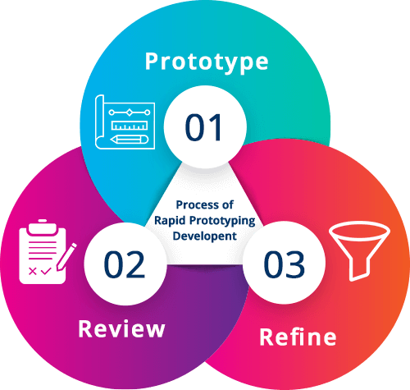
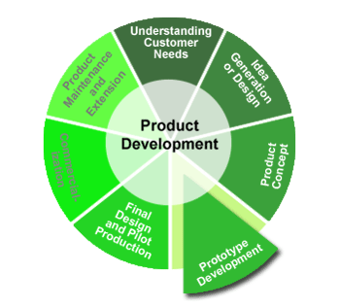
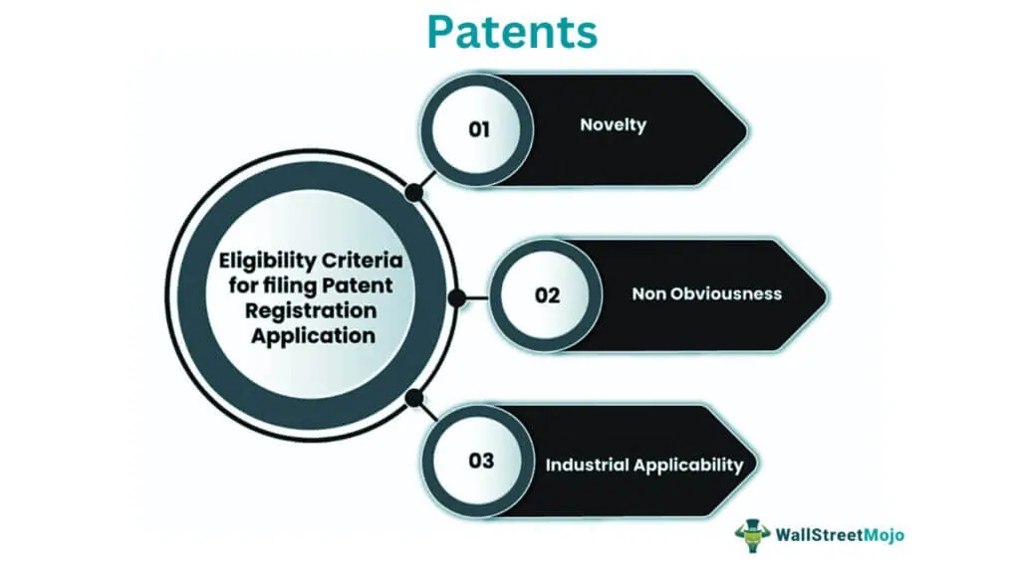
FUTURE PLAN
Design upgradation
Gaining inputs from Industries
Thermal and CFD analysis

Slide 18
Thank You

